Slide 1


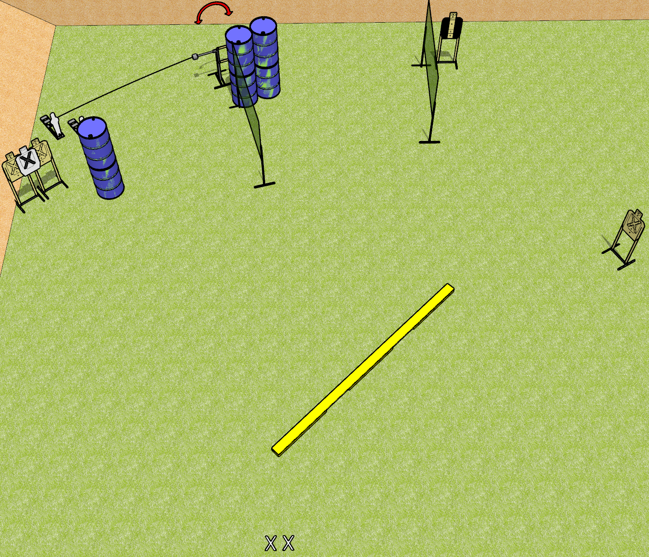
 | Dothan Gun Club – USPSA Match Not the Plank! Course Designer : Drew Coleman
START POSITION : Standing with both feet on X’s, wrists below belt
GUN READY CONDITION : Pistol loaded and holstered. PCC loaded, safety on, buttstock on belt. |  | SCORING: Comstock, 12 rounds TARGETS: 5 paper, 2 Steel SCORED HITS: Best 2 on paper, steel until down START-STOP: Audible, last shot RULES:
STAGE PROCEDURE: Engage targets as they become available from within the fault lines.

Slide 2
Not the Plank!
Written Stage Briefing
Not the Plank! is a 12 round, 60 point, Comstock Short Course. There are 5 USPSA targets and two mini poppers. The best two hits per target will score. Steel must fall to score. The start signal is audible.
Hangun start position is standing with both feet on X’s, wrists below belt. Handgun is loaded and holstered.
PCC start position is standing with both feet on X’s, loaded carbine held with both hands, safety on, buttstock on belt.
On start signal, engage targets as they become available from the plank.

